Slide 1
Consumer Goods Ad-Hoc Insight
By Muhammad Maarij Zafar

Slide 2
List of “Atliq Exclusives” Market
Provide the list of markets in which customer "Atliq Exclusive" operates its business in the APAC region.

Slide 3
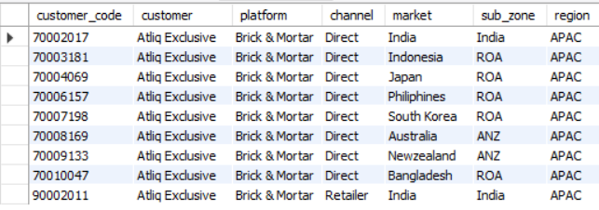
Output

Slide 4
Output to Visual Conversion
→

Slide 5
Analysis
Atliq Exclusives has a diverse market presence across the APAC region, indicating strong regional expansion.
The company relies on physical retail outlets for distribution in all countries, suggesting a customer-facing business model.
This highlights a strategy focused on direct customer engagement rather than third-party channels.

Slide 6
Percentage of Unique Product Increase
What is the percentage of unique product increase in 2021 vs. 2020? The final output contains these fields:
unique_products_2020
unique_products_2021
percentage_chg

Slide 7

Output

Slide 8
Output to Visual Conversion
→

Slide 9
Analysis
There was a 136% increase in the number of unique products from 2020 to 2021, reflecting a significant expansion in product variety.
This suggests that companiers are actively diversifying their portfolio to meet evolving consumer demands

Slide 10
Unique Segments
Provide a report with all the unique product counts for each segment and sort them in descending order of product counts. The final output contains 2 fields:
segment
product_count

Slide 11
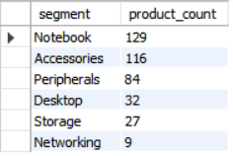
Output

Slide 12
Output to Visual Conversion
→

Slide 13
Analysis
The Notebook segment leads with 129 products, indicating high product concentration in this category.
Other segments like Accessories and Peripherals also show strong product depth, highlighting the strategy to maintain variety across tech categories.

Slide 14
Unique Segment Increase
Follow-up: Which segment had the most increase in unique products in 2021 vs 2020? The final output contains these fields:
segment
product_count_2020
product_count_2021
difference

Slide 15
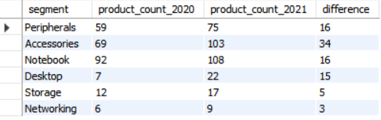
Output

Slide 16
Output to Visual Conversion
→

Slide 17
Analysis
The Accessories segment experienced the highest product increase (+34 units), suggesting growing consumer demand and product innovation.
All segments showed an upward trend, indicating a broad-based expansion strategy in the product development.

Slide 18
Product Manufacturing Cost
Get the products that have the highest and lowest manufacturing costs. The final output should contain these fields:
product_code
product
manufacturing_cost

Slide 19

Output

Slide 20
Output to Visual Conversion
→

Slide 21
Analysis
The data reveals a wide cost spectrum, with substantial differences between the highest and lowest manufacturing costs.
This cost variability highlights the need for cost optimization strategies and targeted pricing for different customer segments.

Slide 22
Average Invoice Discount
Generate a report which contains the top 5 customers who received an average high pre_invoice_discount_pct for the fiscal year 2021 and in the Indian market. The final output contains these fields:
customer_code
customer
average_discount_percentage

Slide 23
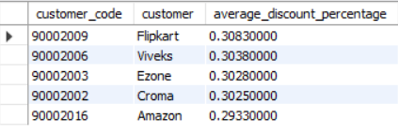
Output

Slide 24
Output to Visual Conversion
→

Slide 25
Analysis
Flipkart received the highest average invoice discount (30.83%), possibly reflecting volume-based purchasing or a strategic partnership.
Overall, discounts are relatively stable across customers, suggesting a consistent pricing strategy.

Slide 26
Gross Sales Amount
Get the complete report of the Gross sales amount for the customer “Atliq Exclusive” for each month. This analysis helps to get an idea of low and high-performing months and take strategic decisions. The final report contains these columns:
Month
Year
Gross sales Amount

Slide 27
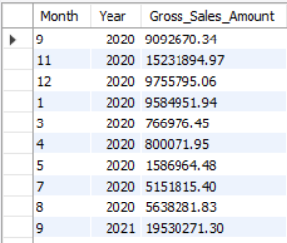
Output

Slide 28
Output to Visual Conversion
→

Slide 29
Analysis
February reported the highest monthly sales, while May was the lowest-performing month.
This trend reflects seasonal fluctuations, with weaker performance in summer months.
Strategic initiatives like targeted promotions or product bundling may help boost summer sales.

Slide 30
Sold Quantity per Quarter
In which quarter of 2020, got the maximum total_sold_quantity? The final output contains these fields sorted by the total_sold_quantity:
Quarter
total_sold_quantity

Slide 31
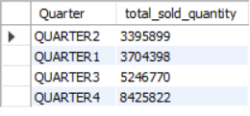
Output

Slide 32
Output to Visual Conversion
→

Slide 33
Analysis
Quarter 4 recorded the highest sold quantity, indicating a strong year-end performance.
Sales in earlier quarters lagged, pointing to opportunities for improving Q1 and Q2 engagement through early-year marketing campaigns or inventory management.

Slide 34
Channel Sales and Contribution
Which channel helped to bring more gross sales in the fiscal year 2021 and the percentage of contribution? The final output contains these fields:
channel
gross_sales_mln
percentage

Slide 35

Output

Slide 36
Output to Visual Conversion
→

Slide 37
Analysis
The Retailer channel dominates with a 73% contribution to gross sales, underlining its importance in the distribution strategy.
However, Direct and Distributor channels contribute less, suggesting an opportunity to diversify sales channels and reduce dependency.

Slide 38
Top Products per Division
Get the Top 3 products in each division that have a high total_sold_quantity in the fiscal_year 2021? The final output contains these fields,:
division
product_code
product
total_sold_quantity
rank_order

Slide 39
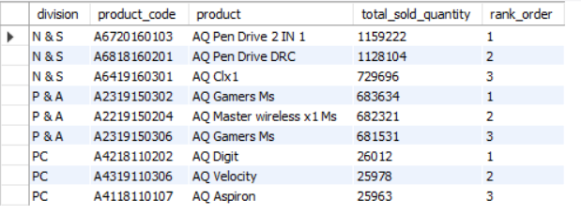
Output

Slide 40
Output to Visual Conversion
→

Slide 41
Analysis
The N & S division outperforms others in total sales, with “AQ Pen Drive 2 in 1” emerging as the top-selling product.
The PC division lags in performance, indicating a potential area for product innovation or marketing investment.

